Slide 1

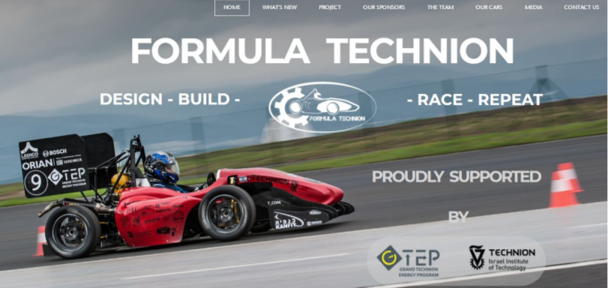
SLAM for Formula Driverless
Lital Guy Maxim Aslyansky
Supervisor: Eli Appelboim
Winter 2018-2019

Slide 2
Project overview
Formula Student is a student engineering competition where student teams from around the world design, build, test, and race a small-scale formula style racing car.
Our contribution to the group:
Reconstruct the race track and estimate the vehicle position on the map while driving (SLAM)

Slide 3
Project Goal
Mapping is crucial to achieve high speed
During the first loop environment map is built
Allows to significantly improve speed by planning beforehand
Main challenges
The algorithm must run in real time (low latency and concurrency issues)
SLAM should be robust to fast motions and tracking failures
Sunlight, uneven road conditions, missing cones

Slide 4
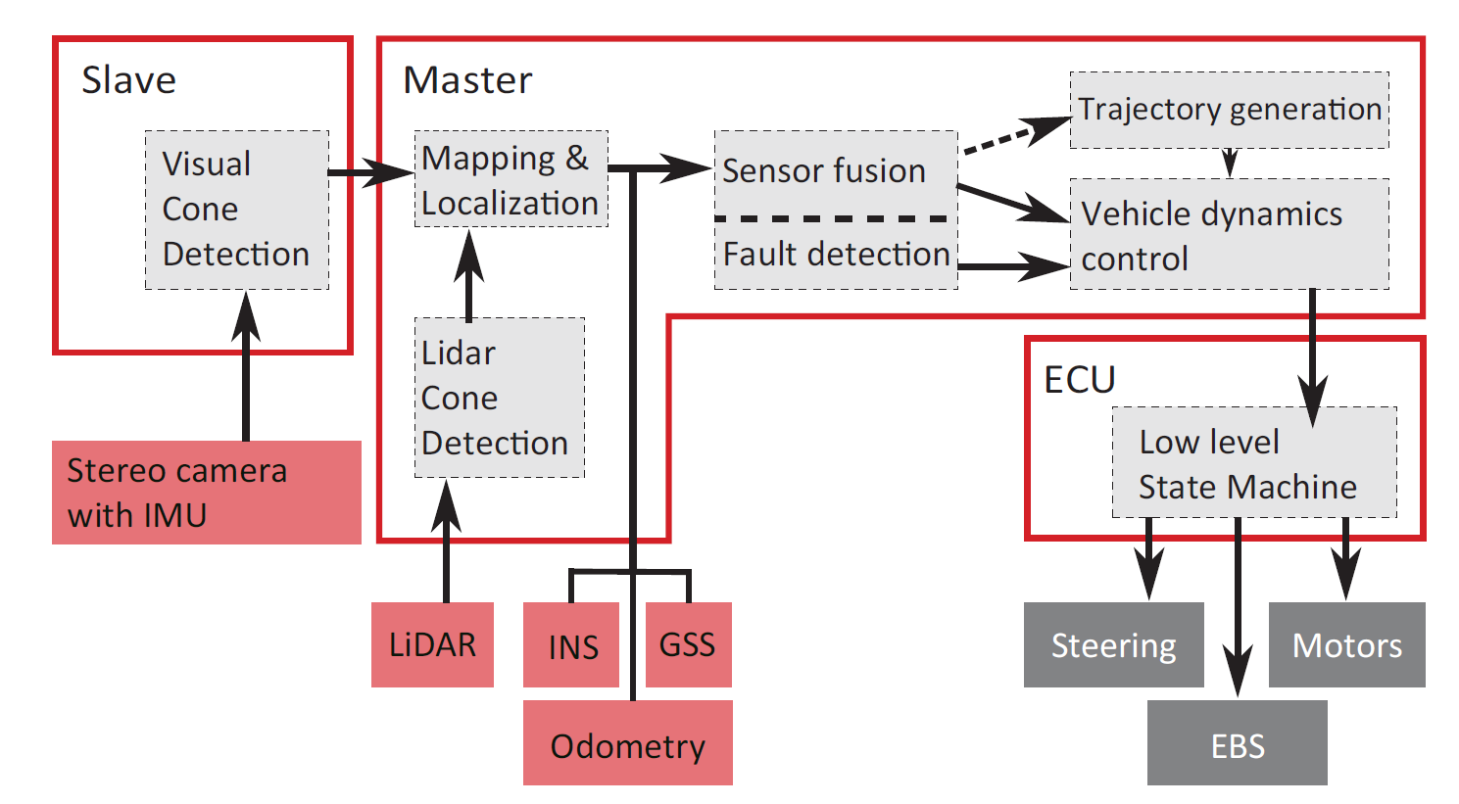
AMZ driverless in-depth overview
System Diagram
Two SLAM pipelines: - visual SLAM (+cones) - LIDAR SLAM (cones only)
Fused by Kalman Filter
Efficient vehicle control

Slide 5
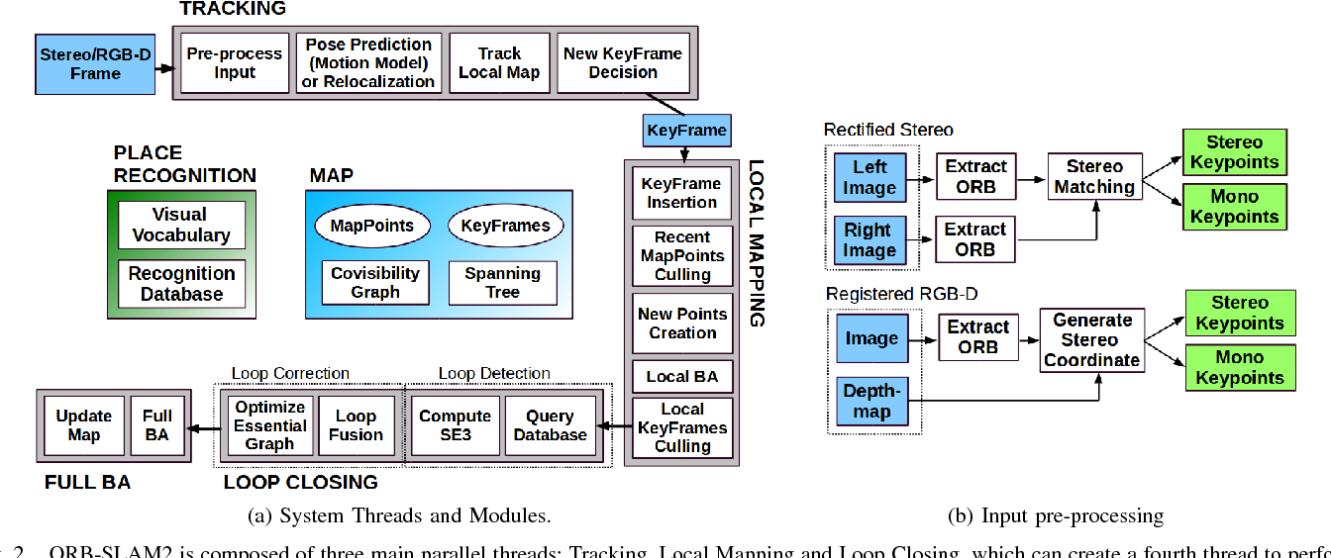
Visual SLAM
SERVO is robust extension to ORB-SLAM 2 used by AMZ Driverless team
First ROVIO (robust visual-inertial odometry) is used to estimate the position
ORB-SLAM 2 is initialized with estimated pose and IMU measurements
ROVIO landmarks and cones integrated into ORB-SLAM as well
ORB-SLAM modified for better robustness to fast motions

Slide 6
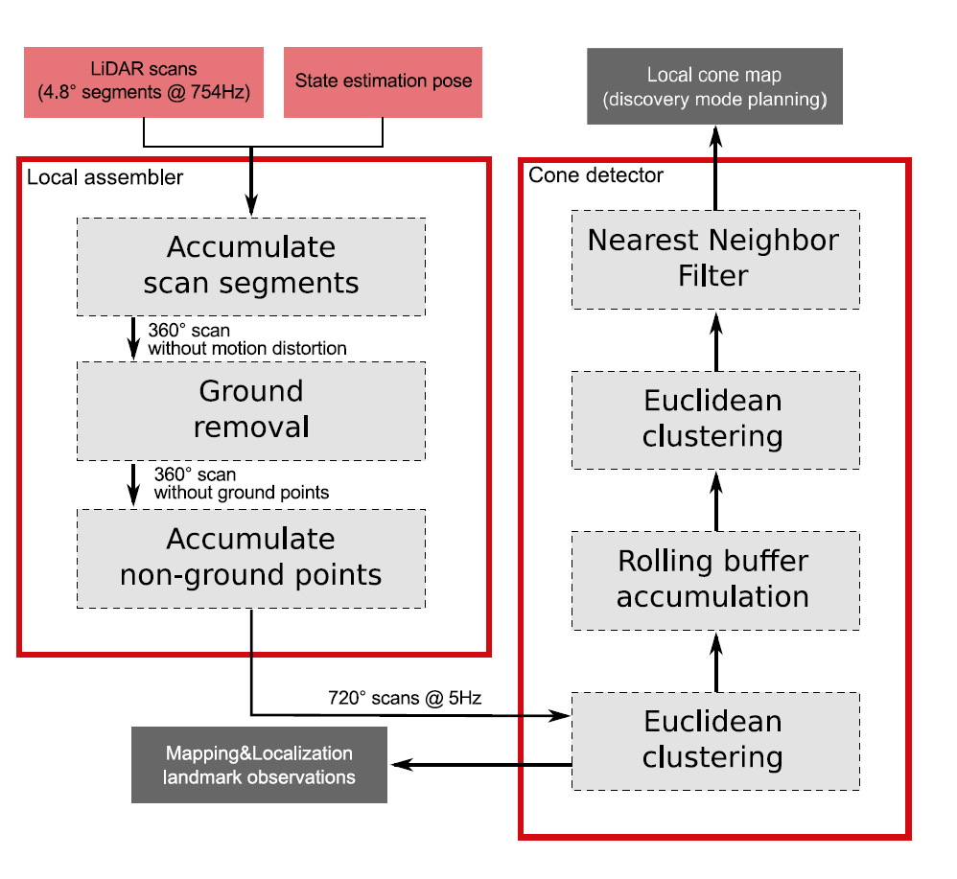
LIDAR SLAM
Point cloud pre-processing
Ground removal, etc.
Cone segmentation and clustering
Local cone map creation
“Fast SLAM” used for mapping
Note that problem is much simpler, Basically “Fusing” multiple maps

Slide 7
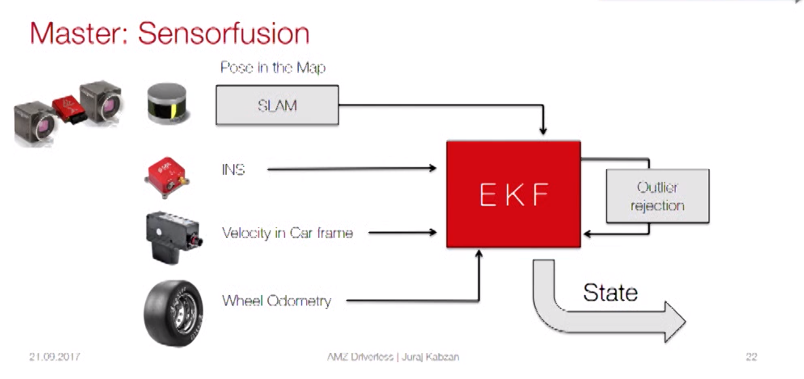
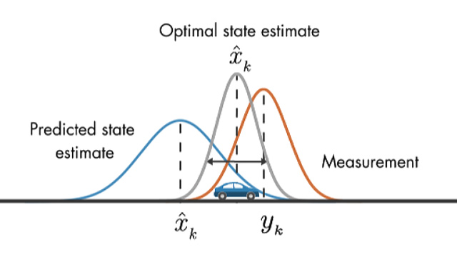
EKF for Data Fusion
Extended Kalman Filter (extended means non-linear)
Used to fuse multiple sources of data
Ensures robustness, accuracy and real-time latency

Slide 8
Vehicle dynamics control
Two modes
Discovery mode:
Active during the first loop, used to build the map, slow
Race mode:
Map must be available
Model Predictive Control with dynamic vehicle model
Source code available

Slide 9
Conclusions
Visual SLAM is not necessary - but used as a back-up to ensure robustness
EKF and MPCC quite difficult - EKF and data fusion could be a separate project - MPCC could be a separate project
Large part of the project is open-sourced - we’ll use that as a starting point

Slide 10
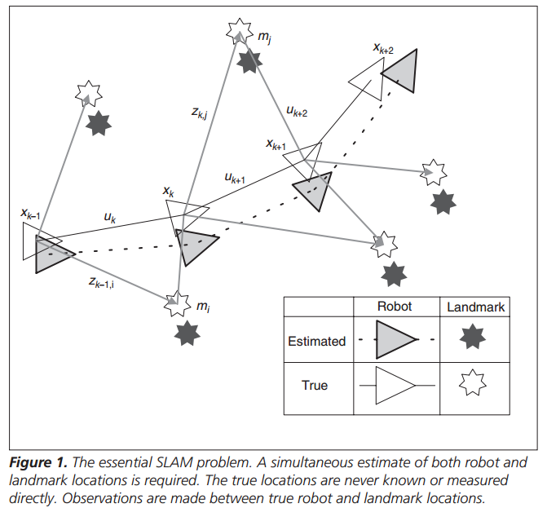
Back-up: SLAM
SLAM stands for Simultaneous Localization And Mapping - mapping = building map of the environment - localization = calculating robot’s position in the map - map = point cloud of landmarks (not necessarily cones) - loop closure = adjusting the map to match loop’s end to the beginning - localization mode = “freezing” the map, estimating only the position

Slide 11
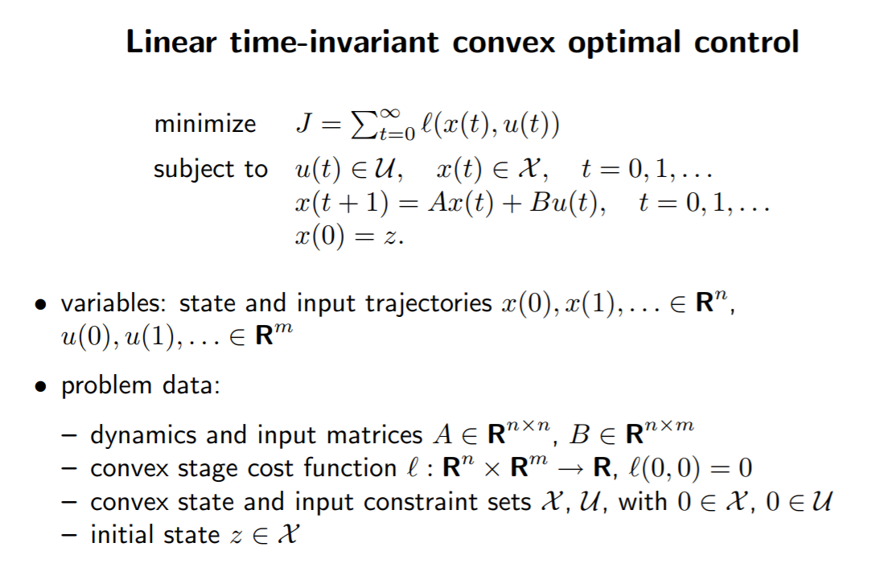
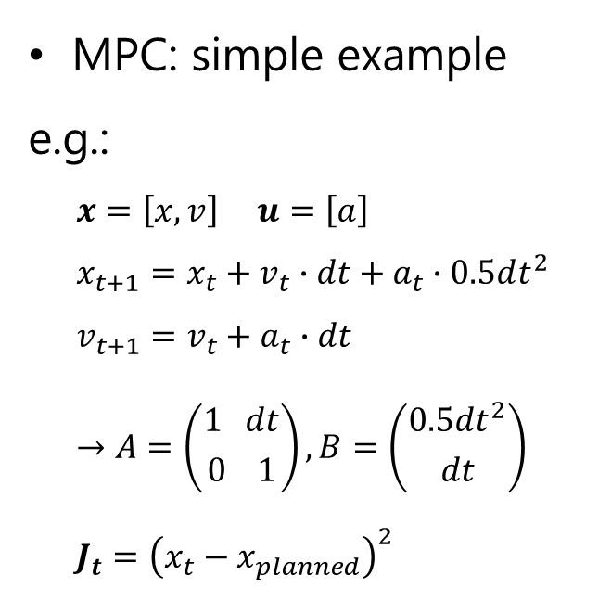
Back-up: MPCC
MPC: simple example
e.g.: $$x=\left[x,v\right] u=\left[a\right] \\ x_{t+1}=x_{t}+v_{t}∙dt+a_{t}∙0.5dt^{2} \\ v_{t+1}=v_{t}+a_{t}∙dt \\ →A=\left({1 dt \atop 0 1}\right), B=\left({0.5dt^{2} \atop dt}\right) \\ J_{t}={\left(x_{t}−x_{planned}\right)}^{2}$$

Slide 12
Back-up: Software
Good software infrastructure framework is crucial for the project ROS used extensively
Open source: VSLAM with data LIDAR data and more data ROS simulator (gazebo) MPCC ROS System skeleton

Slide 13
Back-up: Relevant papers of AMZ Driverless
Talks: 1, 2, 3, 4
Design of an Autonomous Racecar: Perception, State Estimation and System Integration
Redundant Perception and State Estimation for Reliable Autonomous Racing
Learning a CNN-based End-to-End Controller for a Formula Racecar
Path following control for autonomous formula racecar: Autonomous formula student competition
Design of an Autonomous Race Car for the Formula Student Driverless (FSD)

Slide 14
Our Project
Main goal is to build an algorithm to reconstruct the race track during the first loop and provide an estimate of the vehicle’s position on the map while driving (SLAM)
Since the project plays central role in autonomous navigation and perception it will also define the shape of the whole system
Thus, we also need to ensure that SW/HW infrastructure is suitable for a competitive solution in the future

Slide 15
System Overview
Visual Cone Detection
Visual Inertial Odometry (ROVIO)
Visual Inertial SLAM (ORB-SLAM 2)
Sensor Fusion
Map Fusion
Position Estimate
Path Planning
Vehicle Control
Safety Measures
Camera IMU
Point-Cloud Cone
Segme-ntation
“Direct” SLAM (TBD)
LIDAR IMU
Data
Sorce
Done, Needs to be Checked
Our
Task
Future
Work/TBD

Slide 16
Project Timeline Considerations
Limited by data and equipment availability - need a ZED camera (good infrastructure, built-in IMU) with steady cam / stand - waiting for LIDAR - then we’ll need to capture content and make use of it
Adjust roadmap accordingly - while no data available work on theory and open-source - start by testing SERVO on provided data, then test with ours - when LIDAR available, start working on segmentation and mapping

Slide 17
Project Timeline
December
January
February
March
SERVO + cones
LIDAR SLAM
Fusion &
improvements
Testing
SERVO + cones
SERVO code open-sourced
Need to validate and integrate
Later, add cones explicitly
Fusion & improvements
Add maps fusion
Improve the system as a whole
LIDAR SLAM
Currently looking for data
First will need to segment cones
Then we’ll look for an algorithm
Testing
Build a Gazebo simulator
Test in real-world environment
Document the project

Slide 18
Project Goals
Learn about the field, read prior works
Design a skeleton for autonomous navigation system
Design, implement and test relevant algorithms (based on existing solutions)
Validate the system (consider building an end-to-end simulator)
Document the work process
Test on real vehicles
Demonstrate & present the final work

Slide 19
Main Challenges / Open Questions
Data and equipment availability
Need (preferably stereo) camera with IMU, LIDAR, all calibrated and synchronized
Need a couple of sequences in close to real-world scenarios (first loop is slow, next 9 - fast, real cones,..)
Previous work should be finalized and validated
Cone detection – speed/accuracy?
LIDAR synchronization and calibration
Formal system definition
Analyze available options and agree on Roadmap
Agree on SW platform (we tend to ROS: most appropriate but has steep learning curve)
Our task: choose missing components (“direct” SLAM, cone segmentation, etc.)

Slide 20
Good Luck

